Slide 1
Meiosis
Page 145

Slide 2
Meiosis pg 145
Halves the chromosome number to produce cells with a haploid = monoploid number.
Forms gametes (= sperm or eggs).
Has TWO divisions:
  1st halves chromosome number by separating homologous pairs.
  2nd like mitosis, separates chromatids.
Produces 4 daughter cells, each with a different selection of genes from each other thus producing variation in offspring.

Slide 3
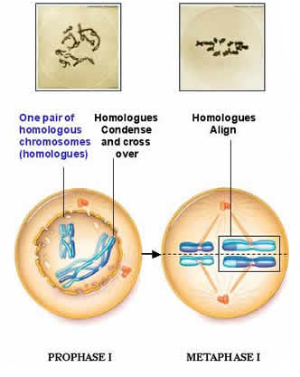
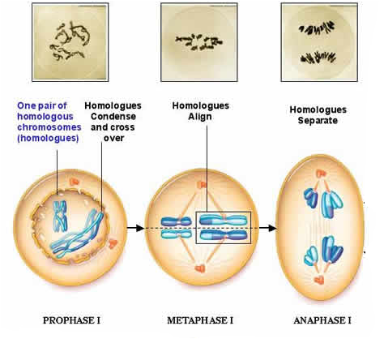
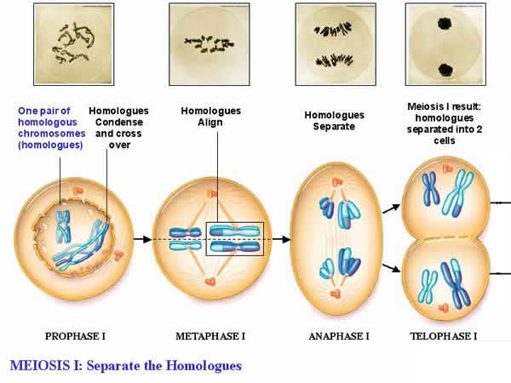
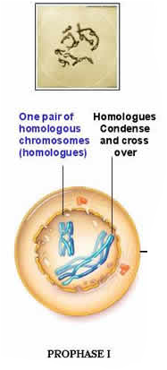
Meiosis I – Separating pairs

Slide 4
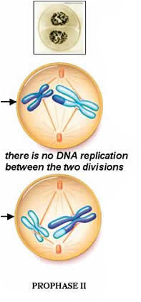
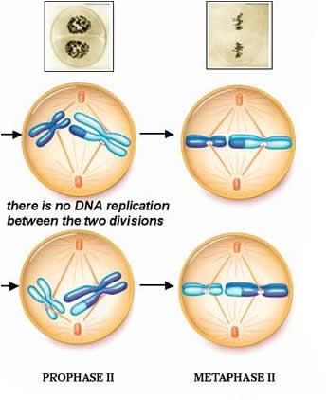
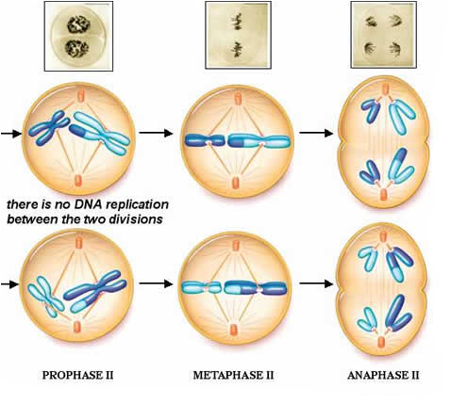
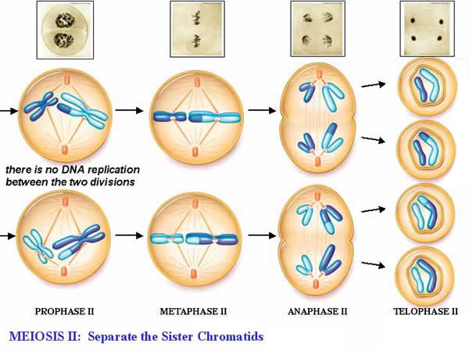
Meiosis II – Separating chromatids

Slide 5
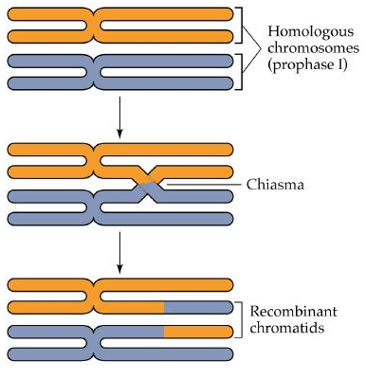
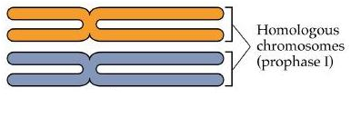
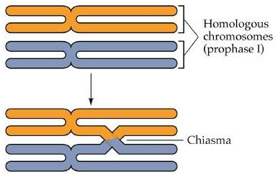
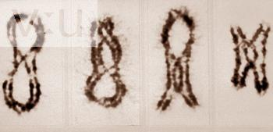
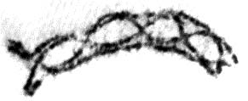
Crossing over
During prophase I, homologous pairs temporarily join at random places called chiasmata and swap pieces of chromatids. This provides variation between the final gametes.
4 chromatids called a ‘tetrad’

Slide 6
Meiosis Animations
Meiosis
Another one
Cross over
Comparing Them
And yet another comparison

